Slide 1

Keyword Driven Framework in Selenium-Part 1

Slide 2
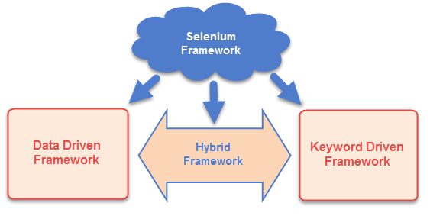
Introduction
Selenium Framework is a code structure that helps to make code maintenance easy.
There are mainly three type of frameworks created by Selenium WebDriver to automate manual test cases
Data Driven Test Framework
Keyword Driven Test Framework
Hybrid Test Framework
In data driven framework all of our test data is generated from some external files like Excel, CSV, XML or some database table

Slide 3
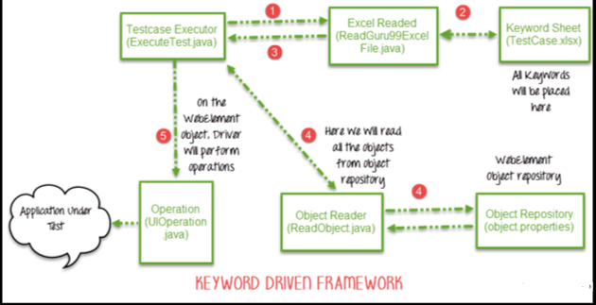
Keyword Driven Framework
Keyword Driven Framework is a type of Functional Automation Testing Framework which is also known as Table-Driven testing or Action Word based testing.
A Keyword or Action Word is a defined combination of actions on a test object which describes how test lines must be executed.
An action word contains arguments and is defined by a test analyst.
In keyword driven test framework, all the operations and Instructions are written in some external file like Excel worksheet.

Slide 4
Components of Keyword Driven Framework
Create a Keyword driven framework, need following components to achieve the task are:-
Excel Sheet- Identify the keywords and store them in an Excel sheet
Function Library- Function library consist of the function for the business flows. So when test is executed, it will read the keyword from the Excel sheet and call the functions accordingly
Data Sheets- Data sheets is used to store the test data that will be used in the application
Object Repository- based on your keyword driven framework you can use an object repository
Test Scripts- Based on the design of your framework, you can have test scripts for each manual Test Case or a single driver script

Slide 5
Advantages of Keyword Driven Framework
Maintenance is low in the long run:-
Test cases are concise
Test cases are readable for the stake holders
Test cases easy to modify
New test cases can reuse existing keywords more easily
Keyword re-use across multiple test cases
Not dependent on a specific tool or programming language

Slide 6
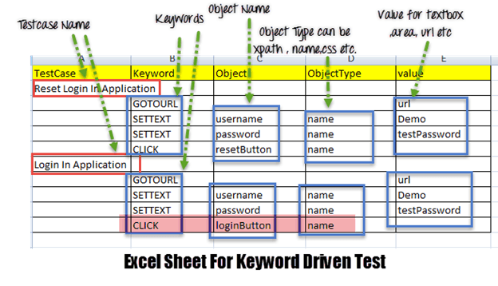
Implementation of Keyword Driven Framework
Step 1)
The driver script Execute.java will call ReadExcelFile.java
ReadExcelFile.java has POI script to read data from an Excel.
Step 2)
ReadExcelFile.java will read data from TestCase.xlsx
Here is how the sheet looks like-
According to the keywords written in Excel file, the framework will perform the operation on UI.

Slide 7
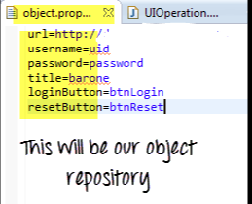
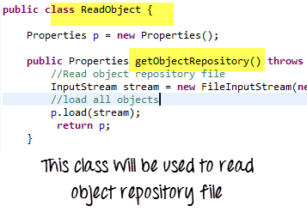
Step 3) ReadExcelFile.java will pass this data to the driver script Execute.java
Step 4)
For all of our UI web elements, create an object repository where we will place their element locator (like Xpath, name, CSS path, class name etc.)
Execute.java (our driver script) will read the entire Object Repository and store it in a variable
To read this object repository, need a ReadObject class which has a getObjectRepository method to read it.

Slide 8
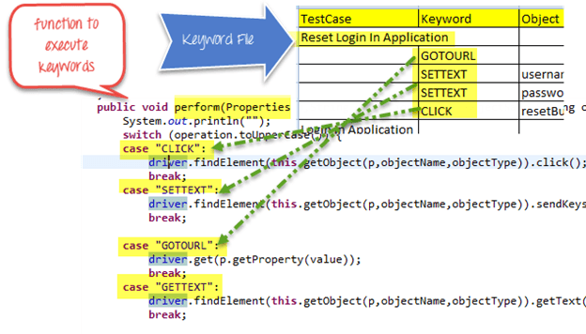
Step 5)
The driver will pass the data from Excel & Object Repository to UIOperation class
UIOperation class has functions to perform actions corresponding to keywords like CLICK, SETTEXT etc… mentioned in the excel
UIOperation class is a Java class which has the actual implementation of the code to perform operations on web elements

Slide 9
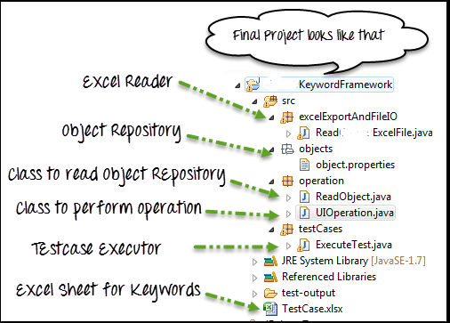
The complete project will look like-

Slide 10
Covered Till Now
Selenium Framework is a code structure that helps to make code maintenance easy.
There are mainly three type of frameworks created by Selenium WebDriver to automate manual test cases
Data Driven Test Framework
Keyword Driven Test Framework
Hybrid Test Framework
In keyword driven test framework, all the operations and Instructions are written in some external file like Excel worksheet.
Components of keyword driven framework.
Advantages of keyword driven framework.

Slide 11
Thanks

